Slide 1


Slide 2





MAS Digital Fabrication
Robotic Dancing!
Let’s make some robots dance! 💃

Slide 3
What is a robot 🤖?

Slide 4
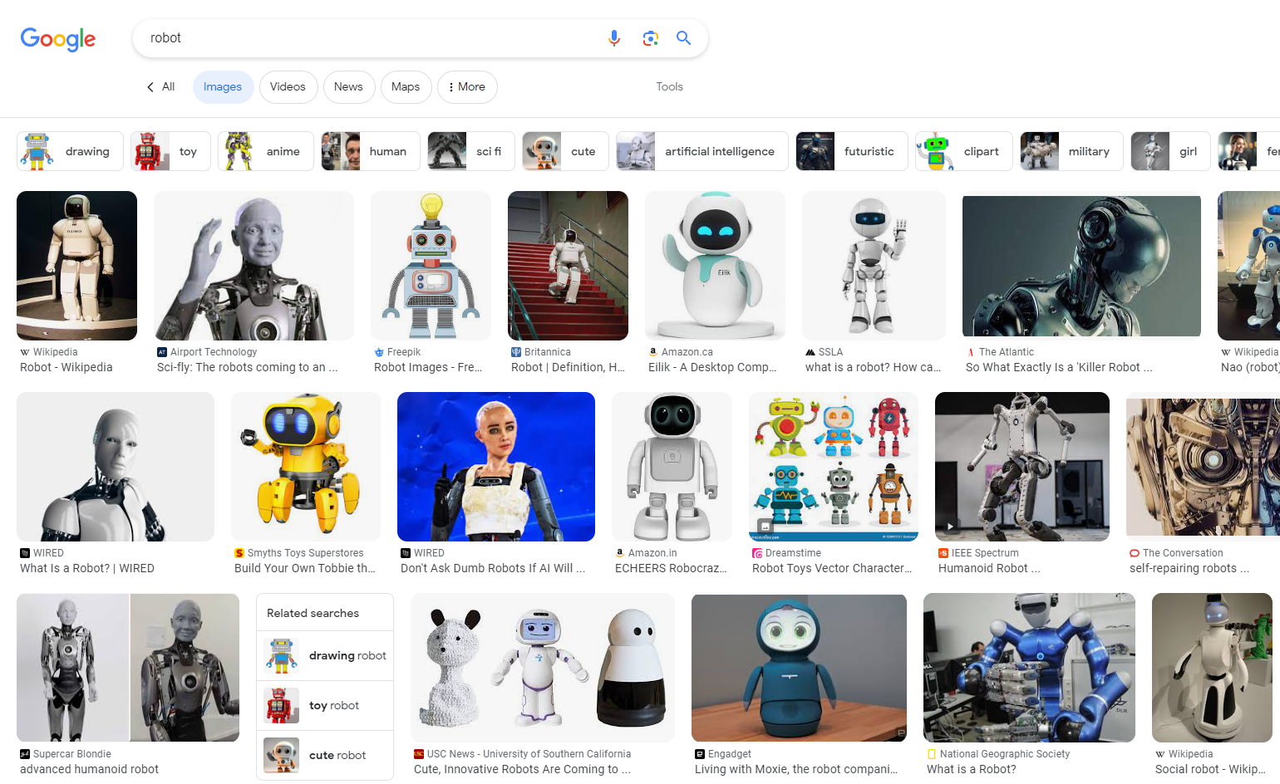

Slide 5
A robot is a machine—especially one programmable by a computer—capable of carrying out a complex series of actions automatically. A robot can be guided by an external control device, or the control may be embedded within.

Slide 6
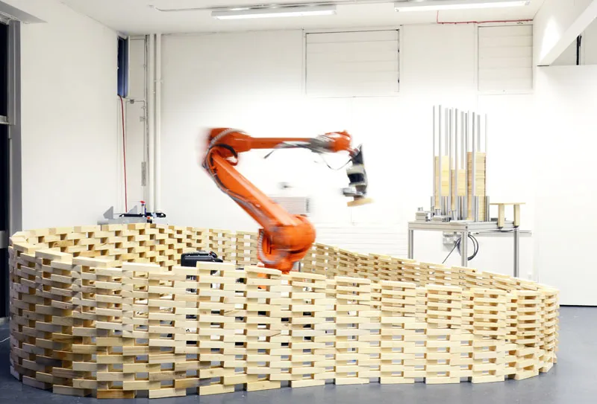
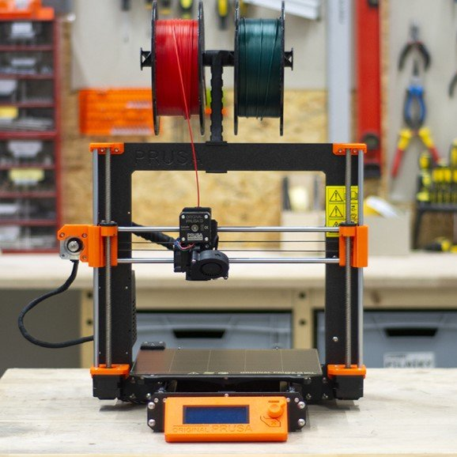
A 6 DOF Industrial Robot making a wall
A 3 DOF Desktop 3D Printer

Slide 7
What is DOF?
(Degrees of Freedom)

Slide 8
In mechanics, degrees of freedom (DOF) is the number of independent variables that define the possible positions or motions of a mechanical system in space. The number of degrees of freedom is equal to the total number of independent displacements or aspects of motion.

Slide 9
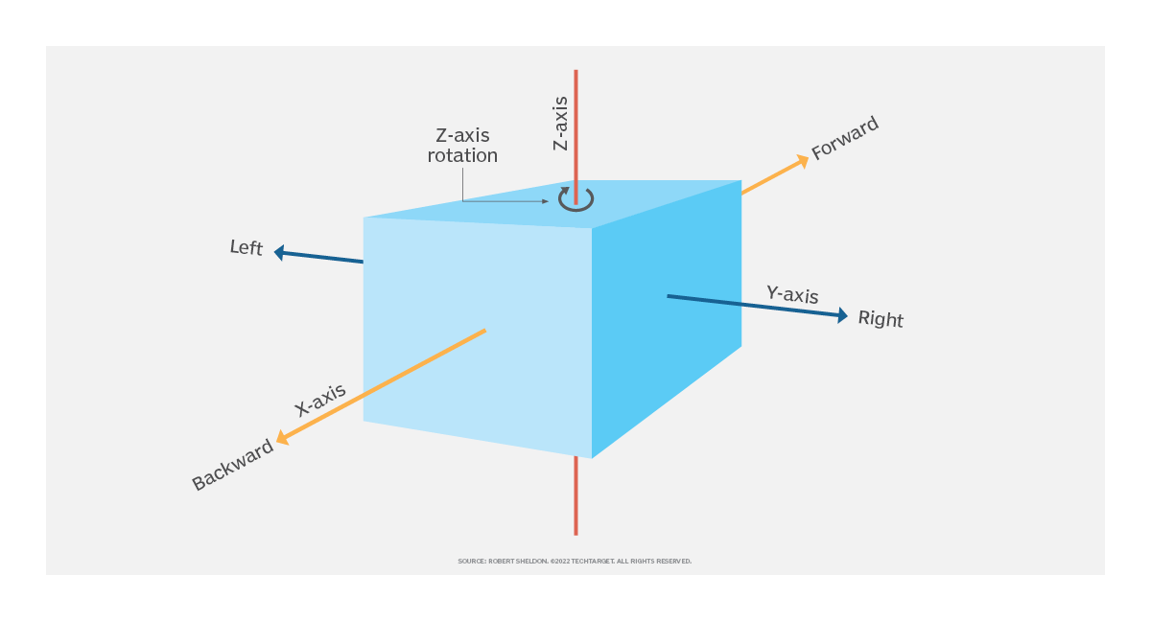

Slide 10
In robotics the term degrees of freedom is widely used to define the motion capabilities of robots, including androids. In this context, the term generally refers to the number of joints or axes of motion on the robot.

Slide 11
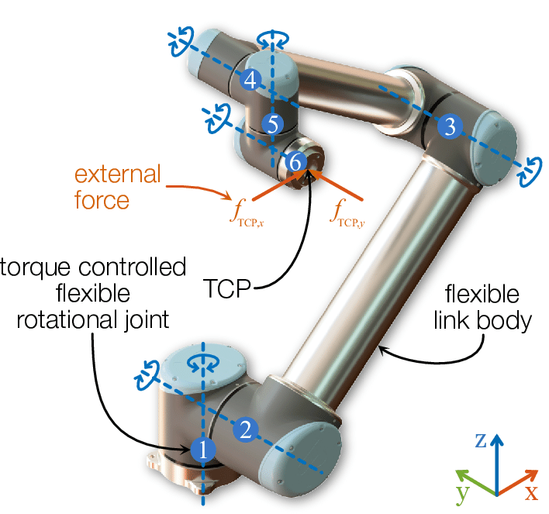

Slide 12
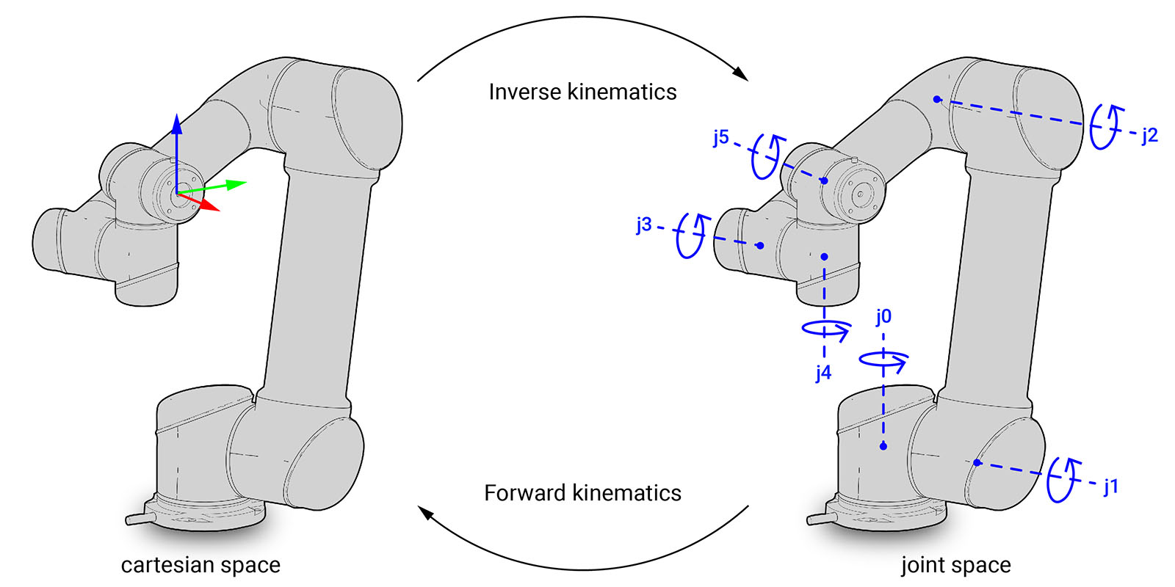

Slide 13
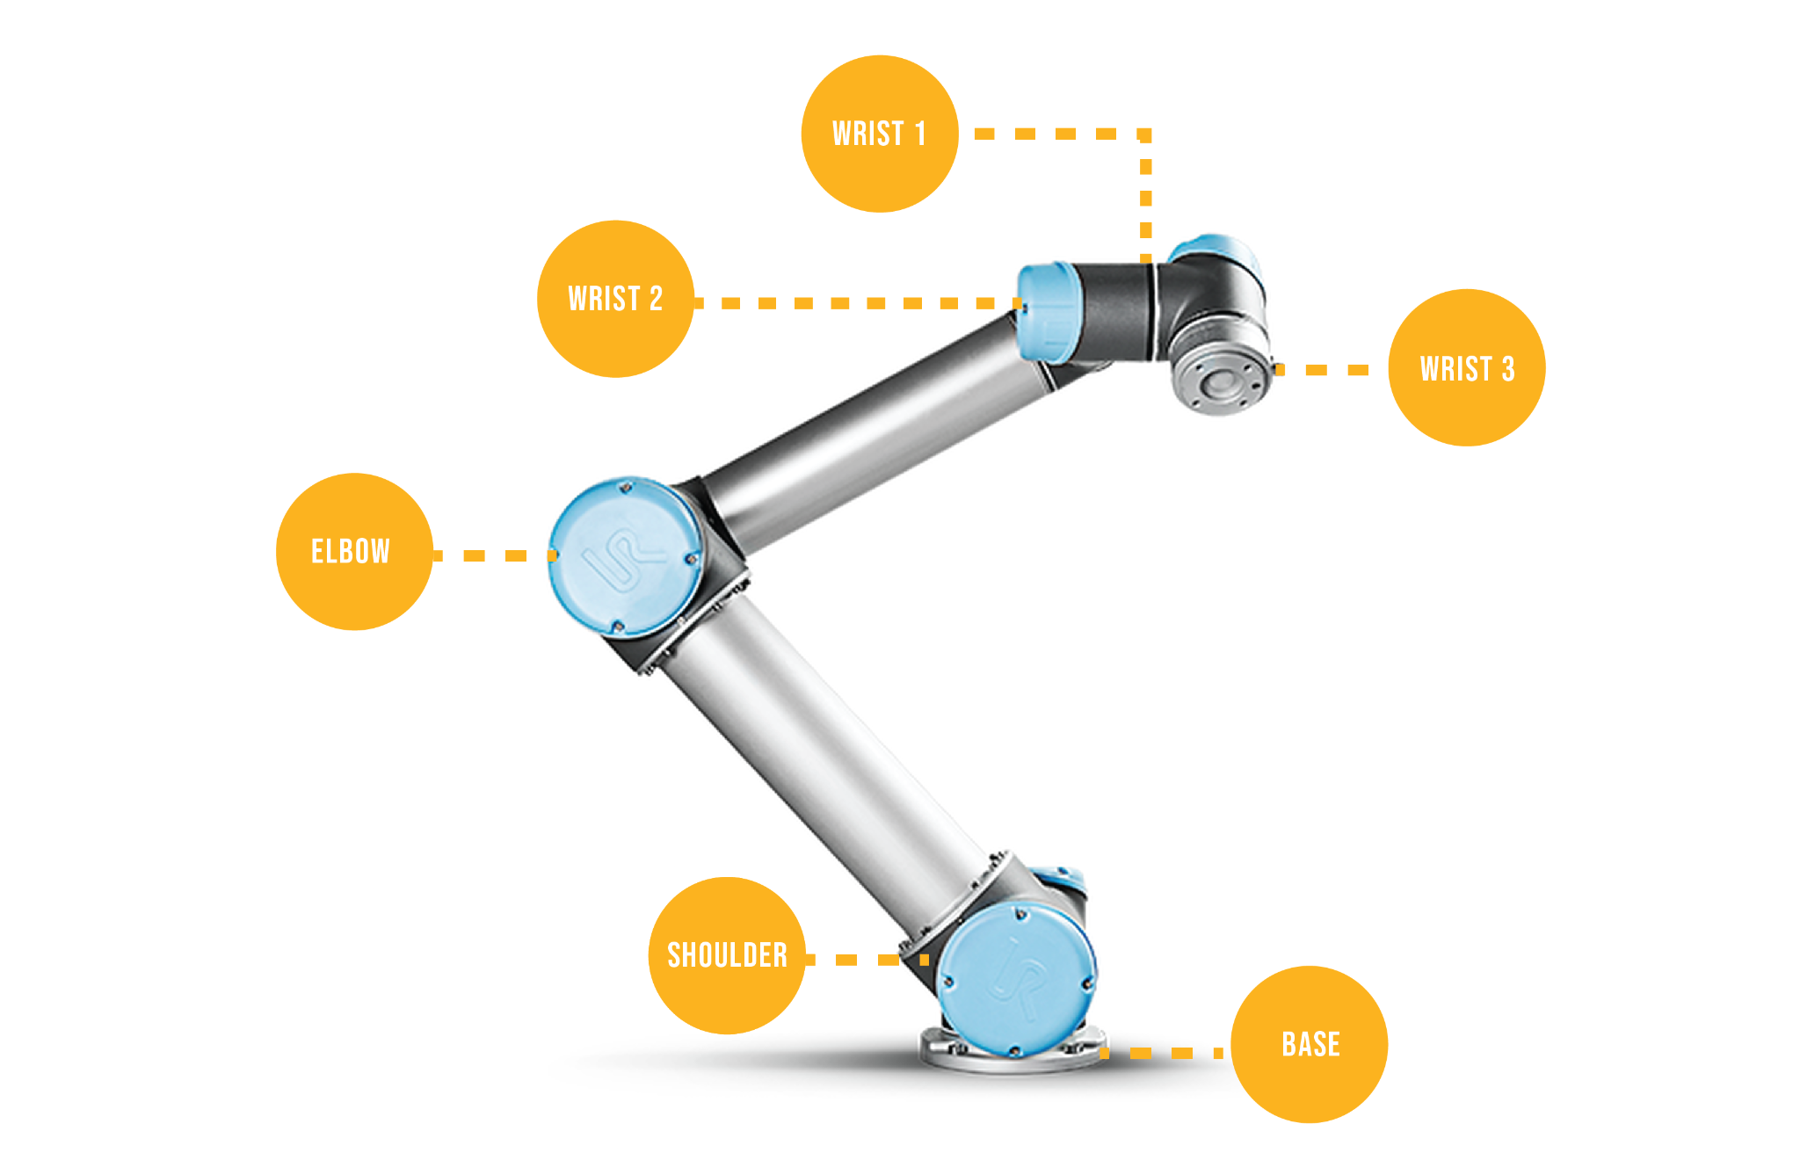
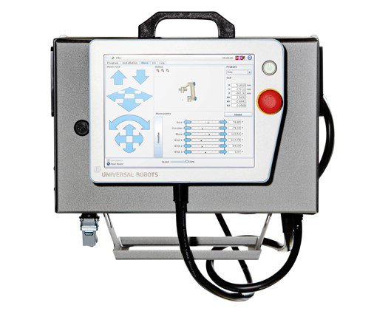

Slide 14
payload, reachability, speed, acceleration, IO, kinematics, e-stop, joints, limits, singularity, motion planning, pendant, end effector, jogging…

Slide 15
Demo!

